Slide 1

AngularJS
Modules

Slide 2
Modules
Creating a module
AngularJS apps are made of modules
A module is a container for the different parts of your app – controllers, services, filters, directives, etc.
Module declaration arguments:
Module name
Dependencies (mandatory! Use an empty array if none)
// a basic module declaration
var myModule = angular.module('myModule', []);

Slide 3
Modules
Adding some elements to a module
Every elements of your app (controllers, services, filters, directives…) must be added to the module
// a basic module declaration
var myModule = angular.module('myModule', []);
// add some directives and services
myModule.service('myService', ...);
myModule.directive('myDirective', ...);

Slide 4
Modules
Retrieving a module & adding some elements
To retrieve a module : call module() with ONLY the module name!
File app.js
File whatever.js
// a basic module declaration
angular.module('myModule', []);
// retrieving & adding some directives and services
var myModule = angular.module('myModule');
myModule.service('myService', ...);
myModule.directive('myDirective', ...);

Slide 5
Modules
Chaining
You can chain-add elements to a module
// retrieving & adding some directives and services
angular.module('myModule')
.service('myService', ...)
.directive('myDirective', ...);

Slide 6
Modules
Splitting in modules
You can split your application in multiple modules:
A module for each feature
A module for each reusable component (especially directives and filters)
And an application level module which depends on the above modules and contains any initialization code.
When working with sub-modules you must use injection to manage the dependency tree
// sub-module
angular.module('xmpl.service', []);
// sub-module
angular.module('xmpl.directive', []);
// main module
angular.module('xmpl', ['xmpl.service', 'xmpl.directive']);

Slide 7
Modules
Module injection
Module injection can also be used to inject angular or 3rd-party modules
Official AngularJS modules:
ngCookies
ngTouch
ngResource
ngMessages
ngAnimate
ngSanitize
…
3rd party modules:
AngularUI Bootstrap
AngularUI Router
Angular Material
Angular Translate
…

Slide 8
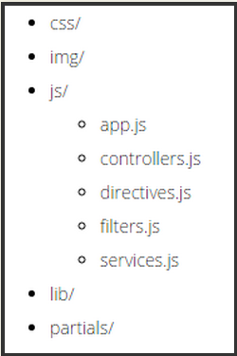
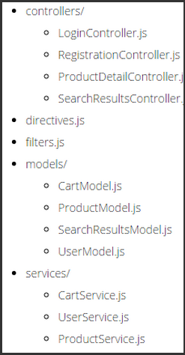
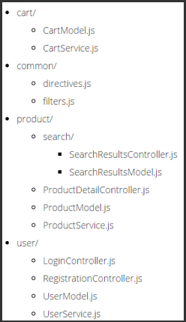
File structure
Basic, small project
Technical
Functional

Slide 9
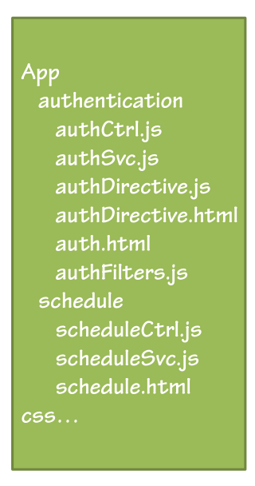
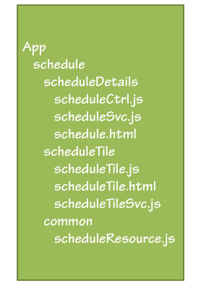
File structure
By feature (simple)
By feature (advanced)

